Slide 1
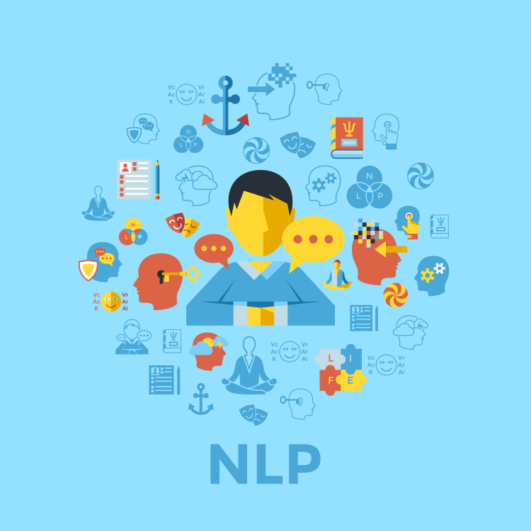
题目 Lesson-08
李老师& 开课吧人工智能学院课程组
2020.03

Slide 2
overview
Sequence to sequence
Encoder decoder architecture
Seq2Seq
Greedy search and beam search
Attention mechanism
Contextualized word representation
From word embedding to ELMo
Transformer
GPT
Bert
GPT2

Slide 3
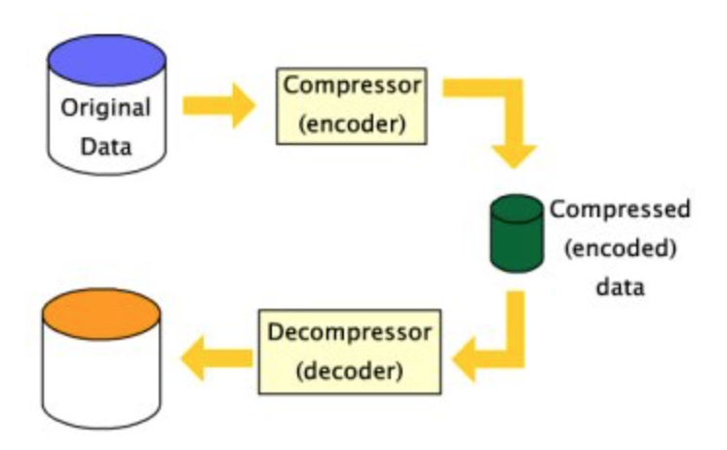
Encoder decoder architecture
The idea of encoder-decoder architecture comes from data compression.

Slide 4
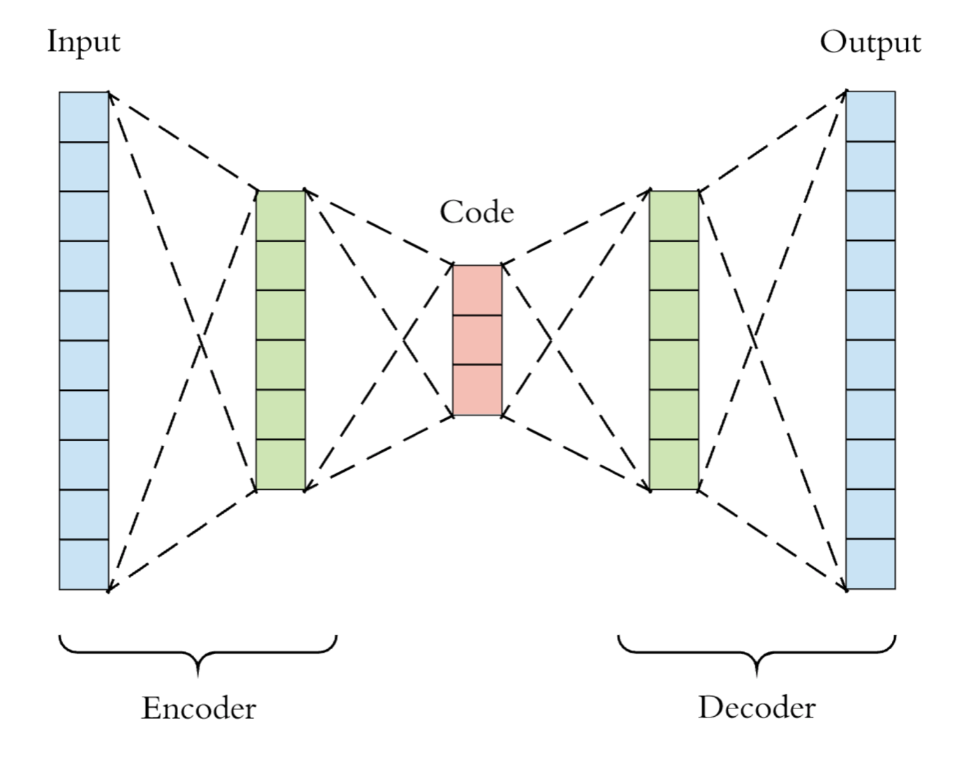
Neural encoder-decoder(autoencoder) architecture

Slide 5
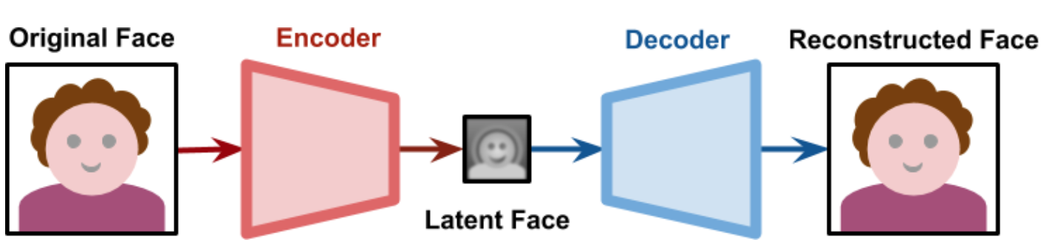
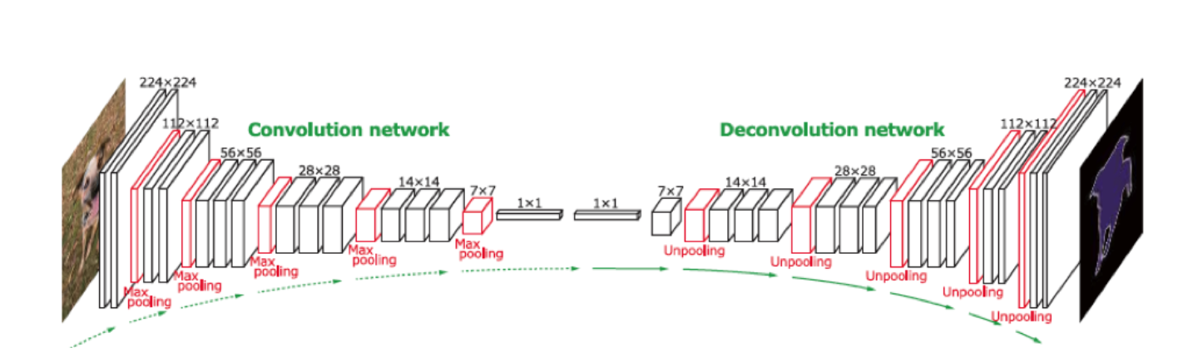
Some applications of cnn based autoencoder

Slide 6
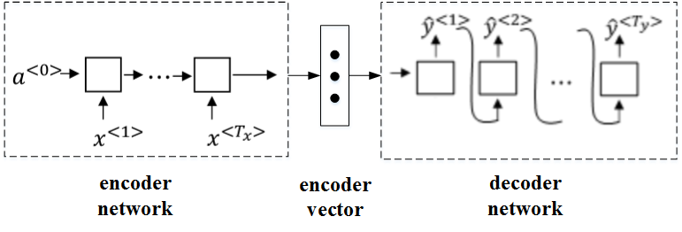
Sequence to sequence

Slide 7
Sequence to sequence( an example of MT with greedy search)
English: I like playing basketball.
Chinese: 我喜欢打篮球
我
喜欢
打
篮球
EOS
I
like
playing
basketball

Slide 8
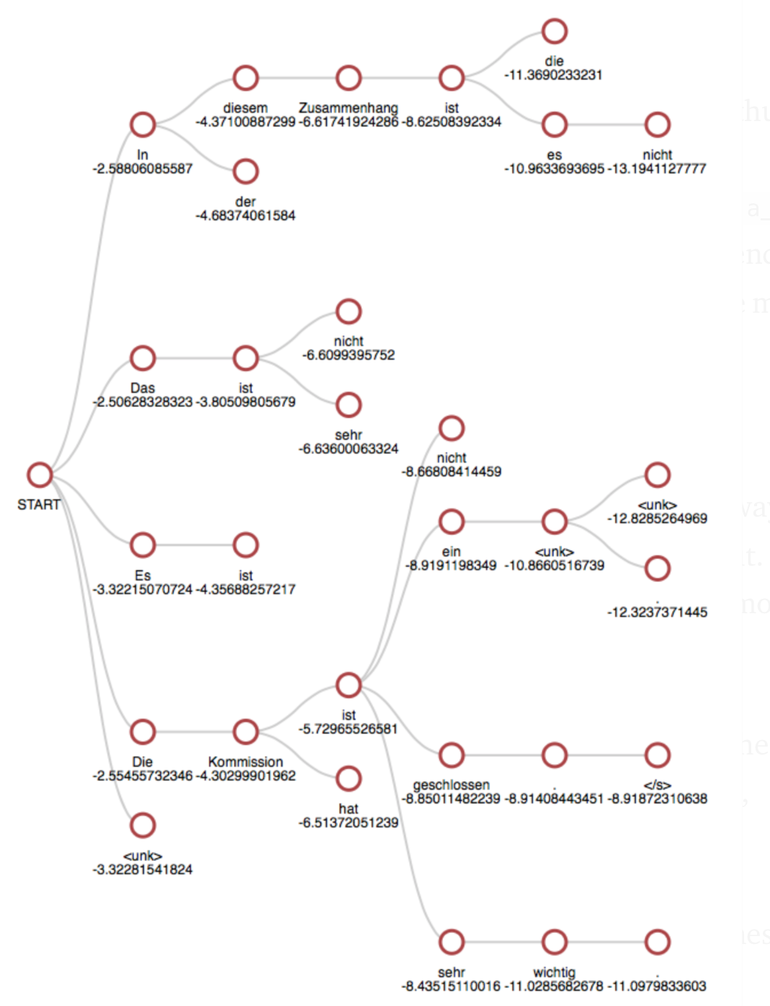
Beam search

Slide 9
Beam search(an example)
I
like
playing
basketball

Slide 10
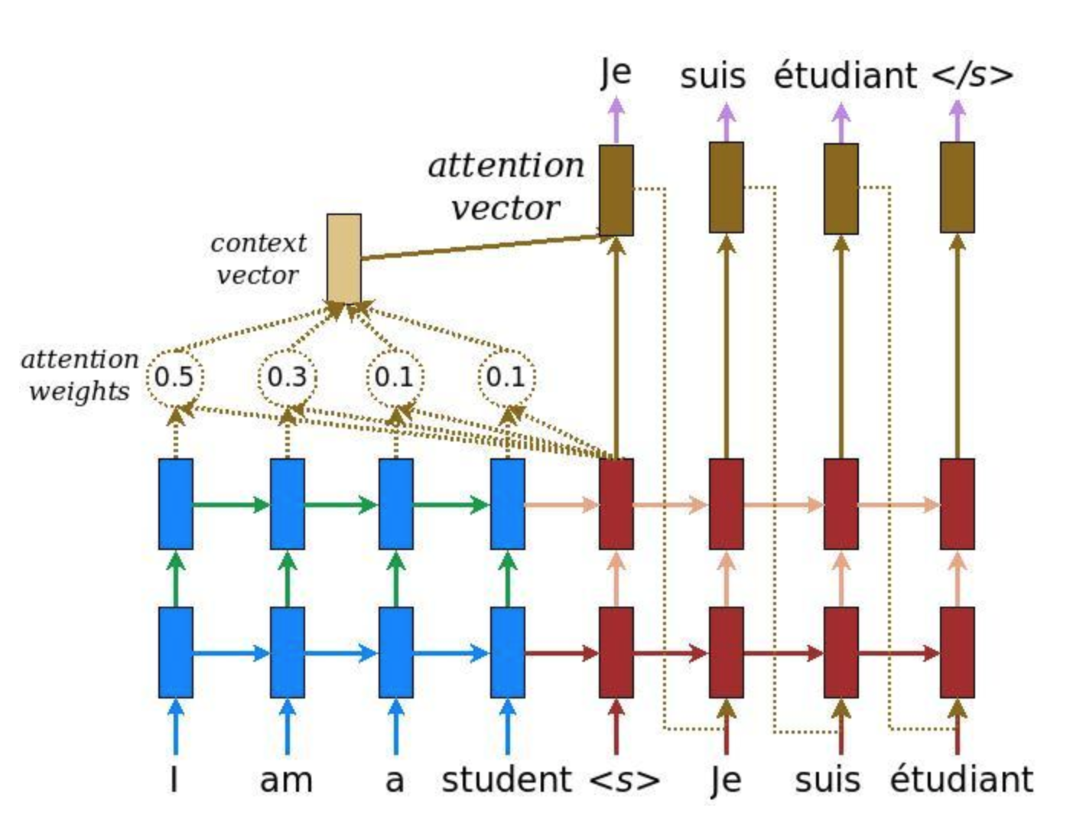
Attention mechanism

Slide 11
Attention mechanism(step by step)

Slide 12
Contextualized word representation

Slide 13
References:
ELMo paper: https://arxiv.org/pdf/1802.05365.pdf
Transformer paper: https://arxiv.org/pdf/1706.03762.pdf
Bert paper: https://arxiv.org/pdf/1810.04805.pdf
GPT paper: https://s3-us-west-2.amazonaws.com/openai-assets/research-covers/language-unsupervised/language_understanding_paper.pdf
GPT2 paper: https://d4mucfpksywv.cloudfront.net/better-language-models/language_models_are_unsupervised_multitask_learners.pdf
Blog: https://jalammar.github.io

Slide 14

Why contextualized word representation.
Sentence 1: I must go to the bank and change some money.
Sentence 2: We pushed the boat off from the rive bank.
Two “bank” have completely different meaning.
However there is only one representation for ”bank”.
How do we solve this problem ?

Slide 15
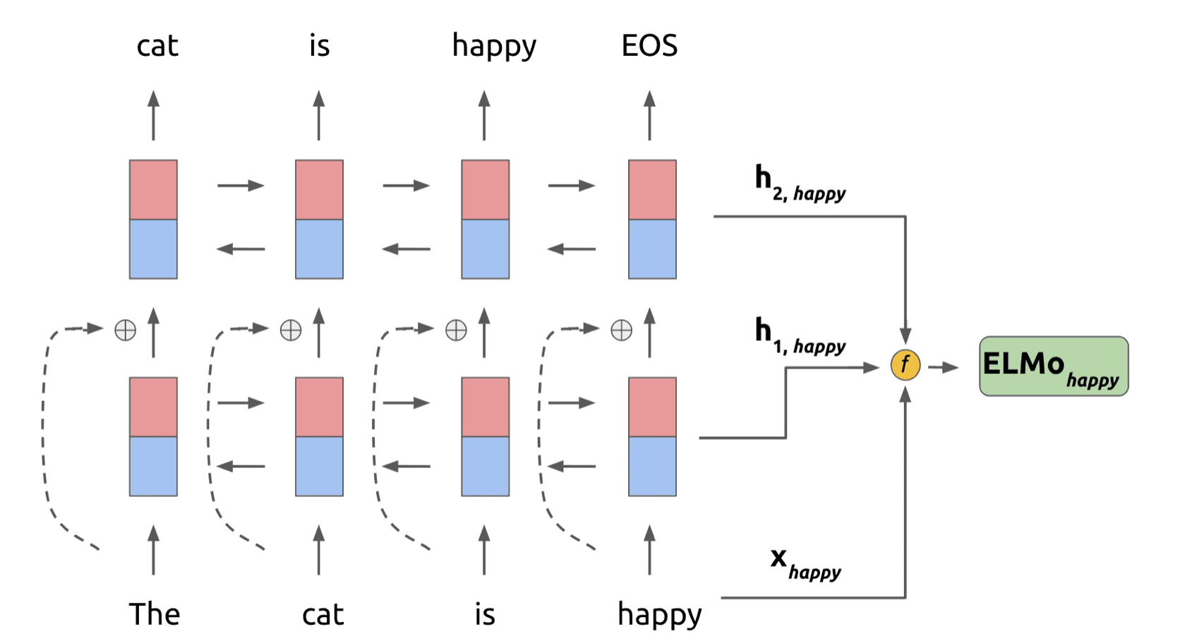
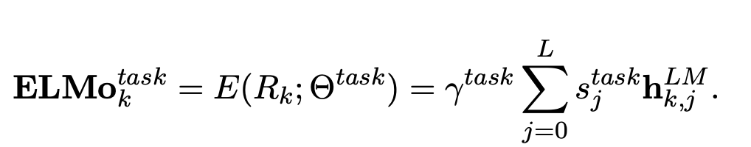
ELMo language model

Slide 16
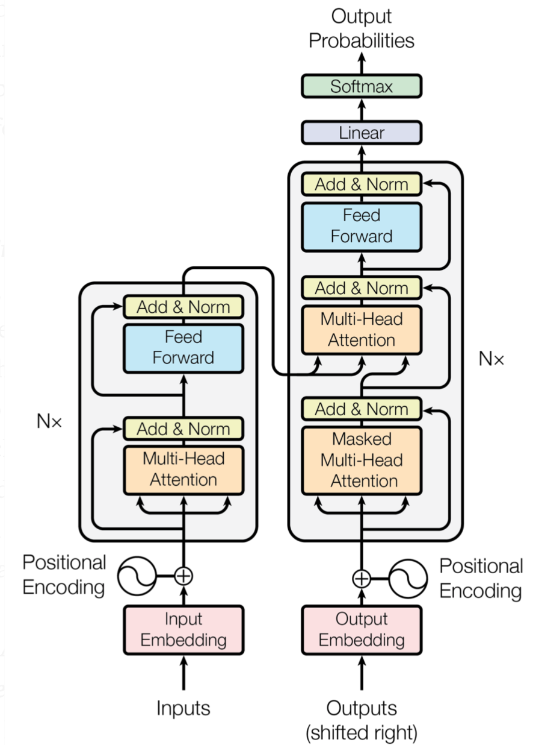
Attention is all your need. (Transformer)

Slide 17
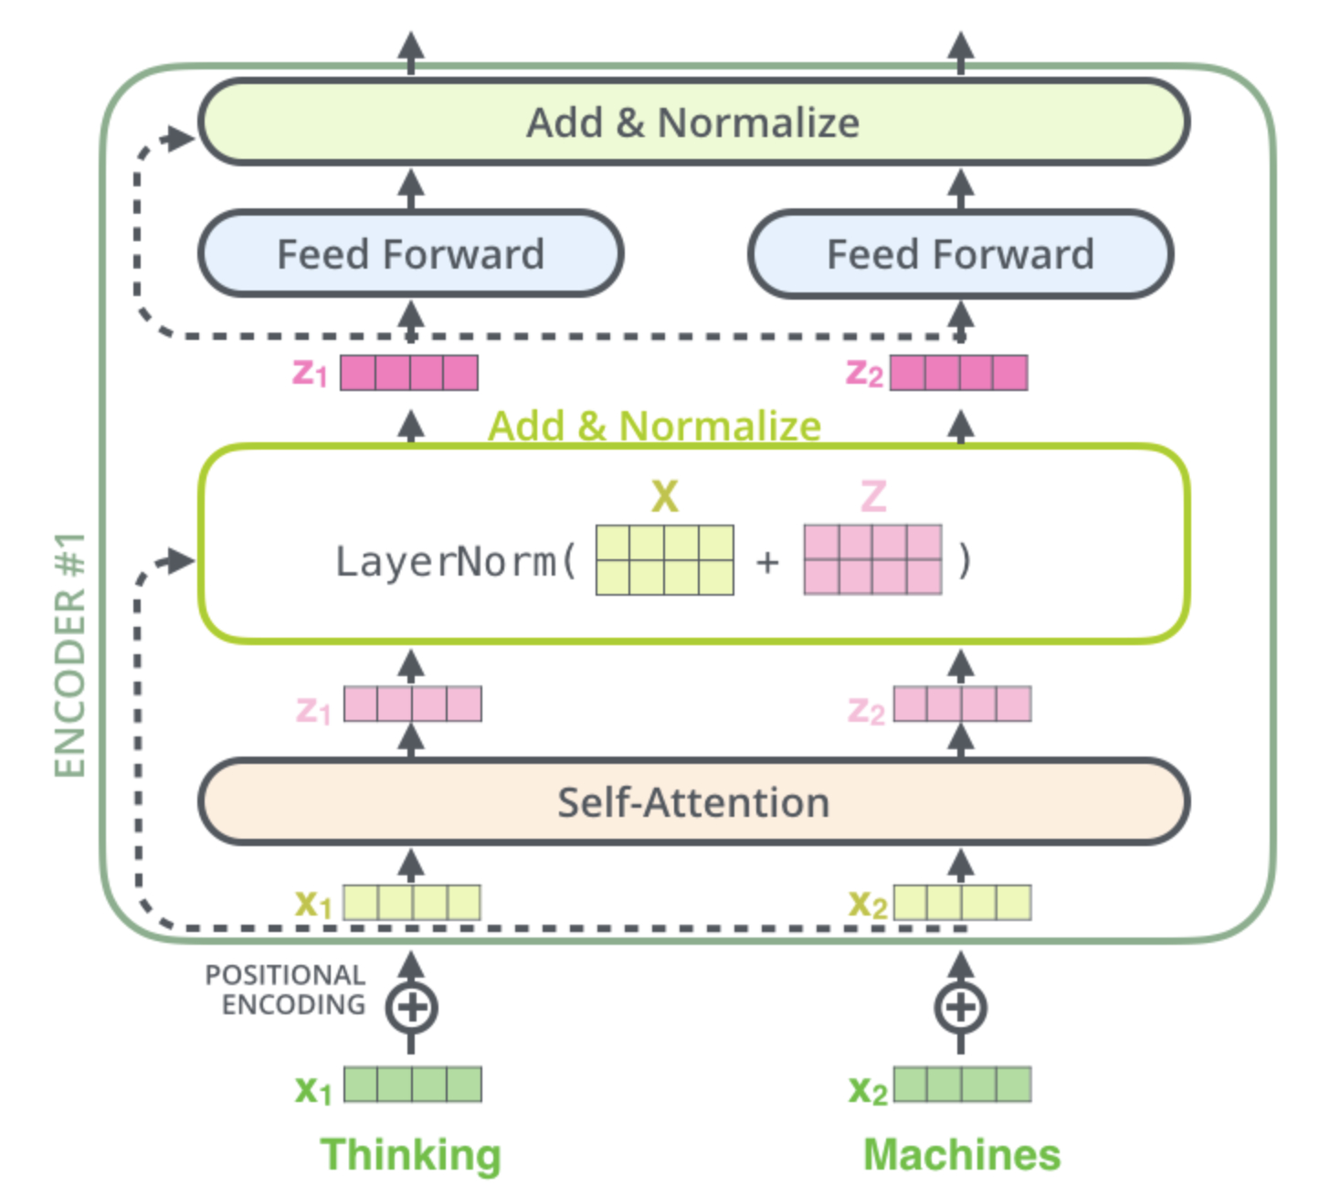
Transformer (Encoder)

Slide 18
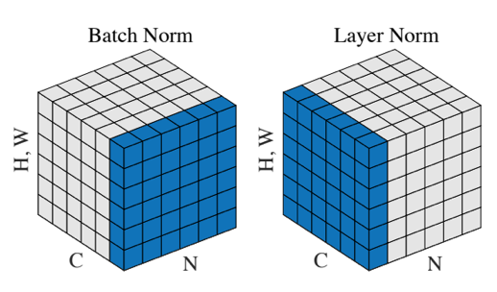
Layer normalization vs batch normalization
Batch size
Sequence length

Slide 19
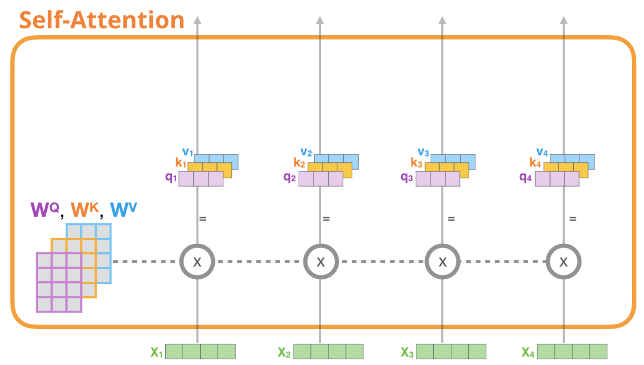
Self-Attention in detail

Slide 20
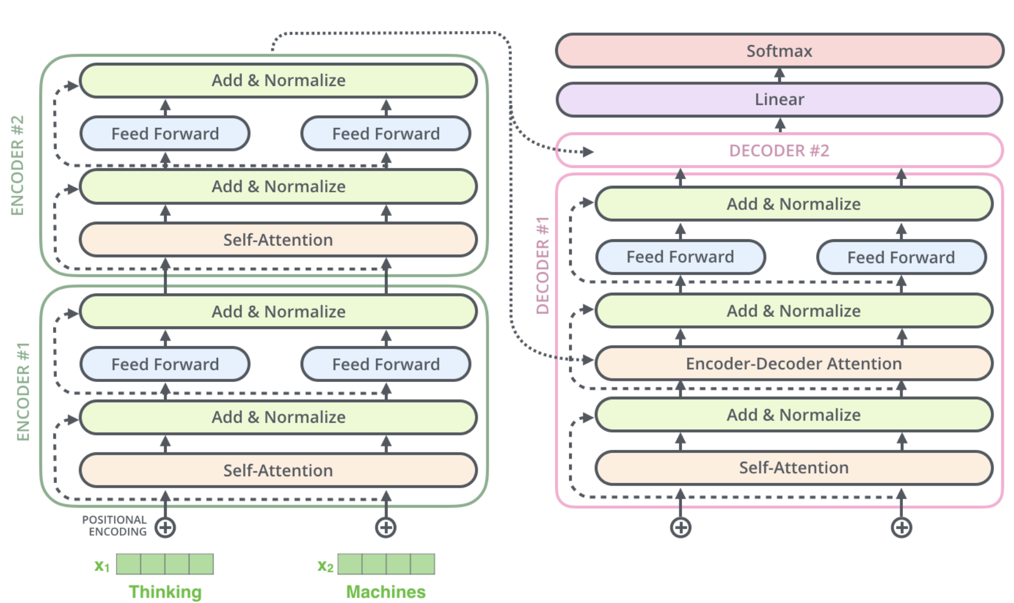
Transformer(Decoder)

Slide 21
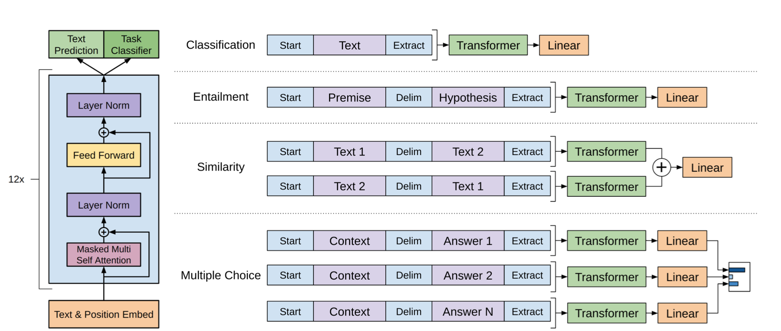
GPT

Slide 22
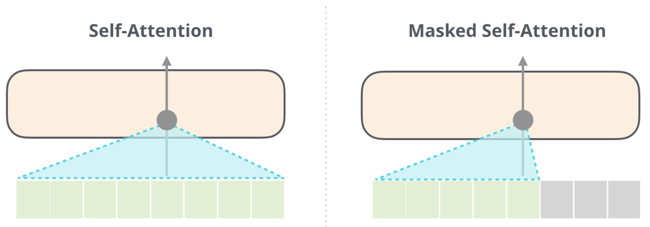
Masked self-attention

Slide 23
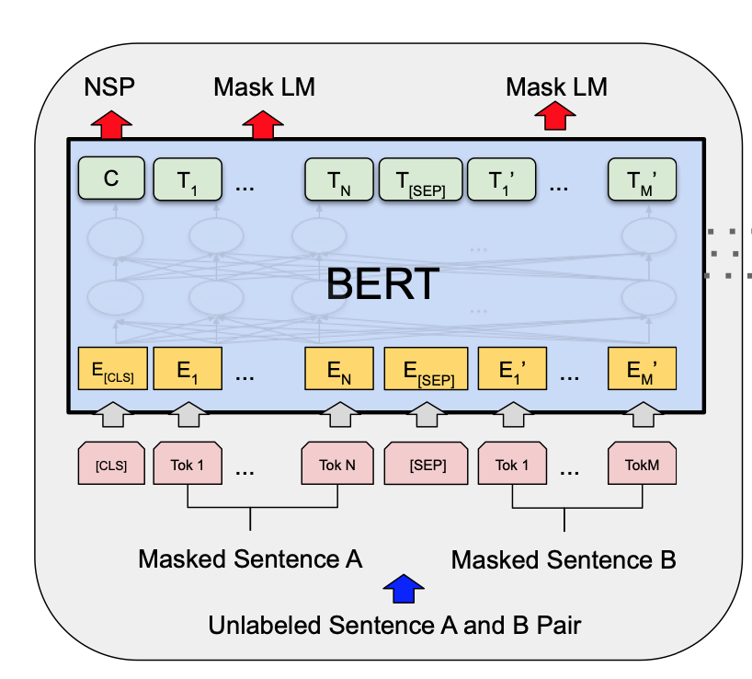
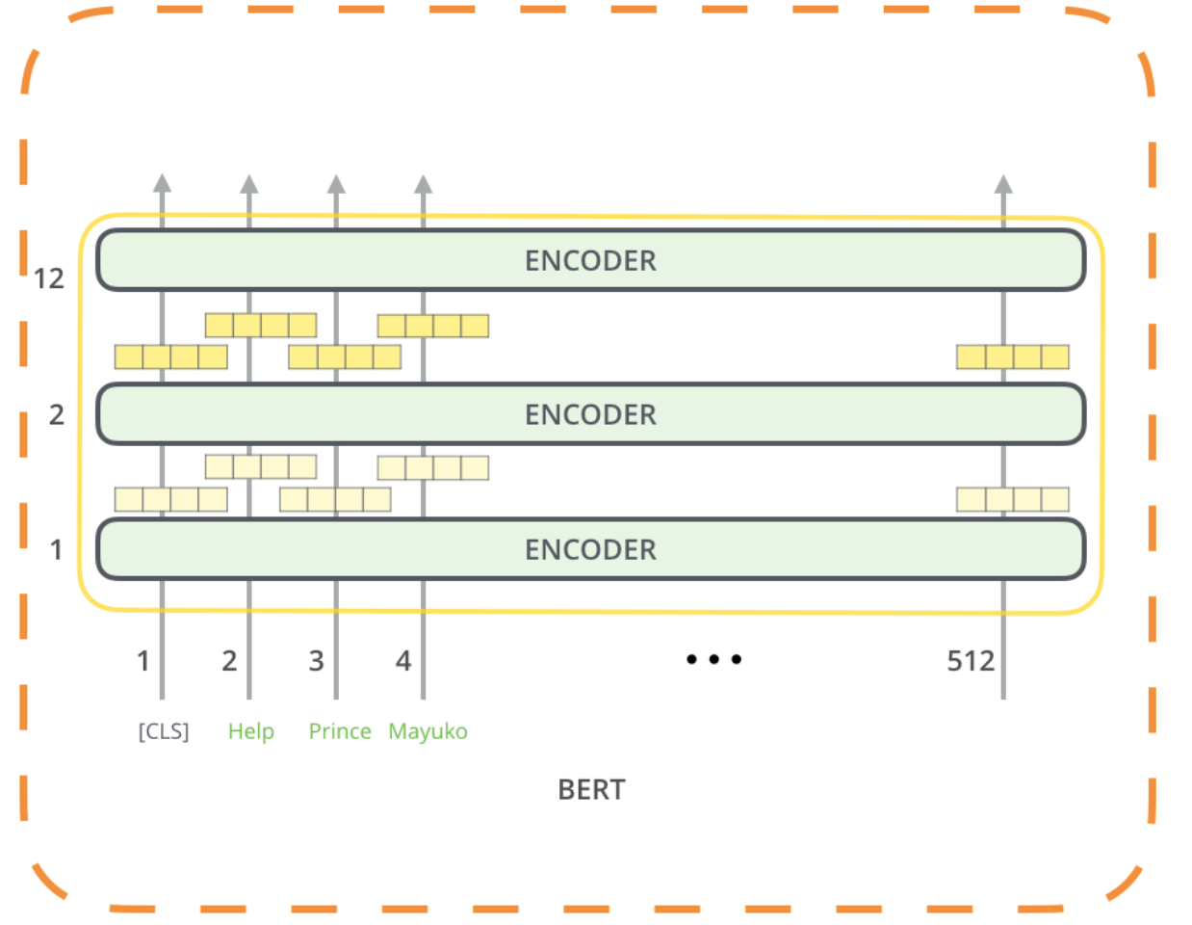
Bert

Slide 24
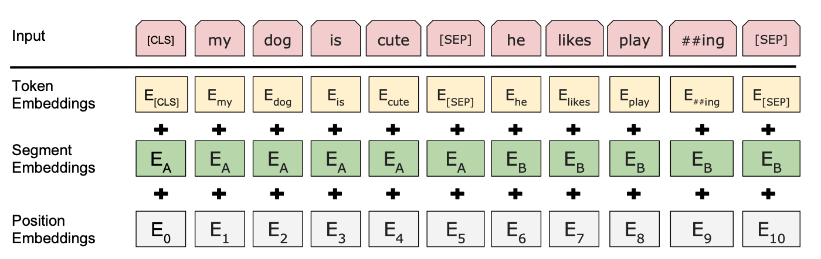
More about Bert

Slide 25
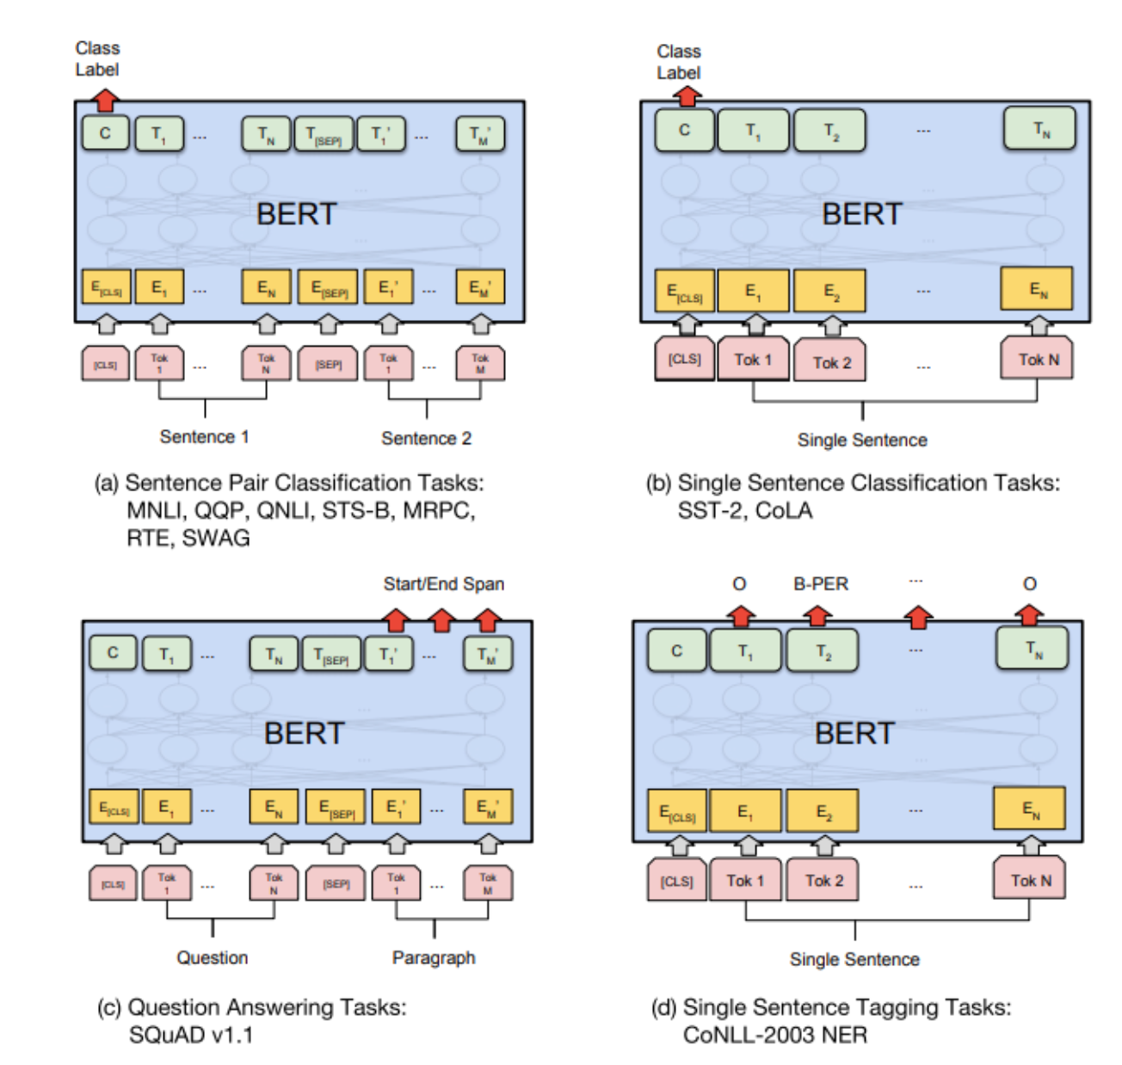
How to use Bert in other NLP tasks.

Slide 26
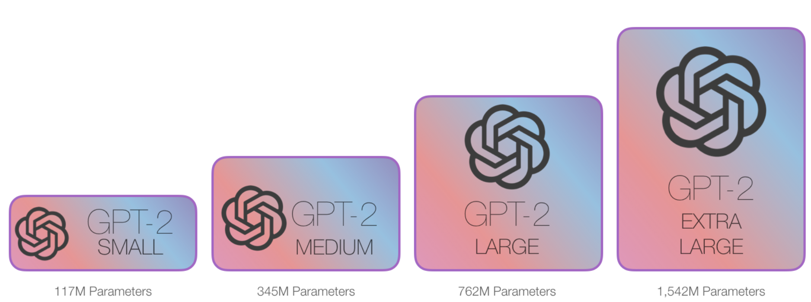
From GPT to GPT2 (More parameters, more data)

Slide 27
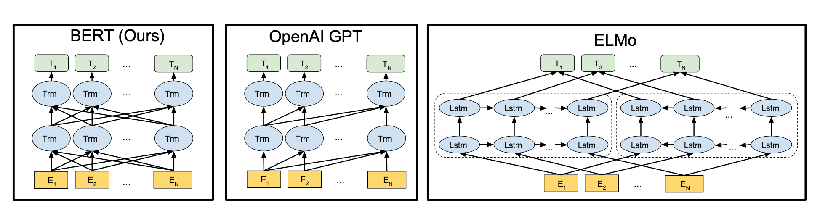
Comparisons

Slide 28
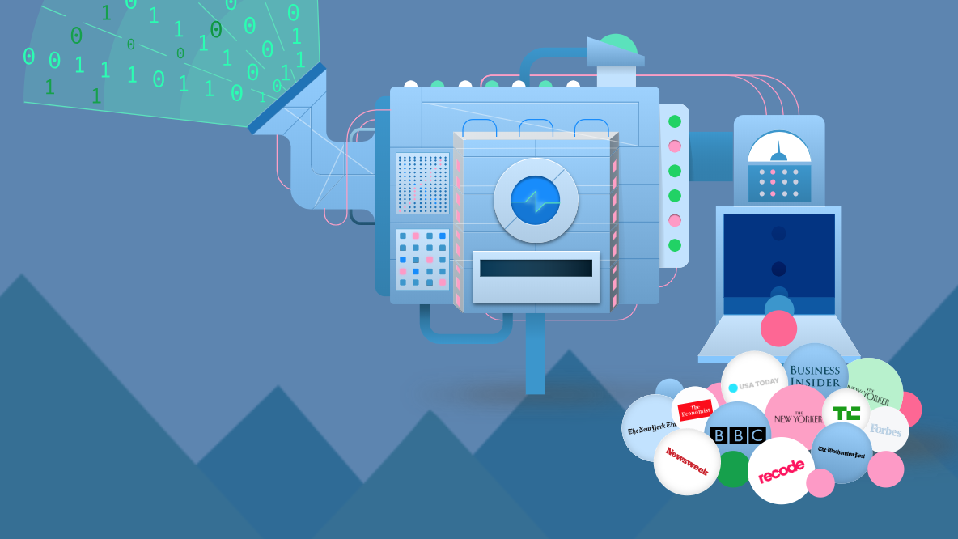
Thanks for your attending

